Slide 1
What is shell? A shell is a program that takes commands typed by the user and calls the operating system to run those commands.
Shell accepts your instruction or commands in English and translate it into computers native binary language.

Slide 2
Kind of Shells
Bourne Shell
C Shell
Korn Shell
Bash Shell
Tcsh Shell

Slide 3
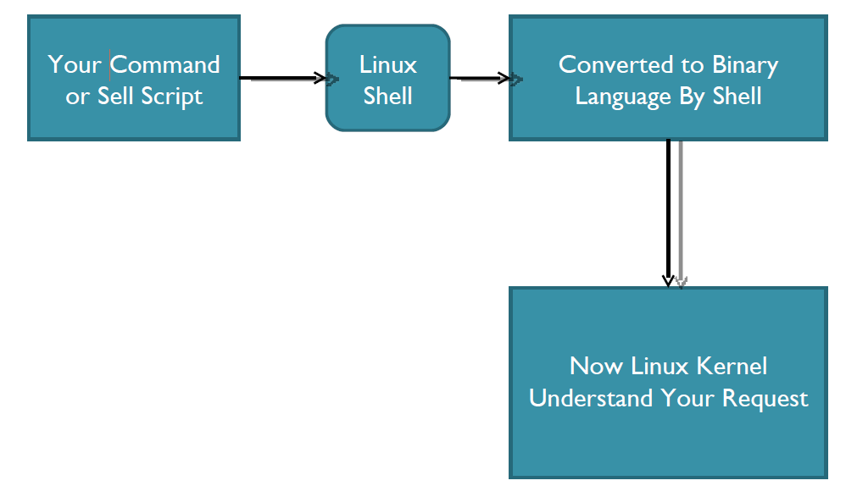
This is what Shell Does for US

Slide 4
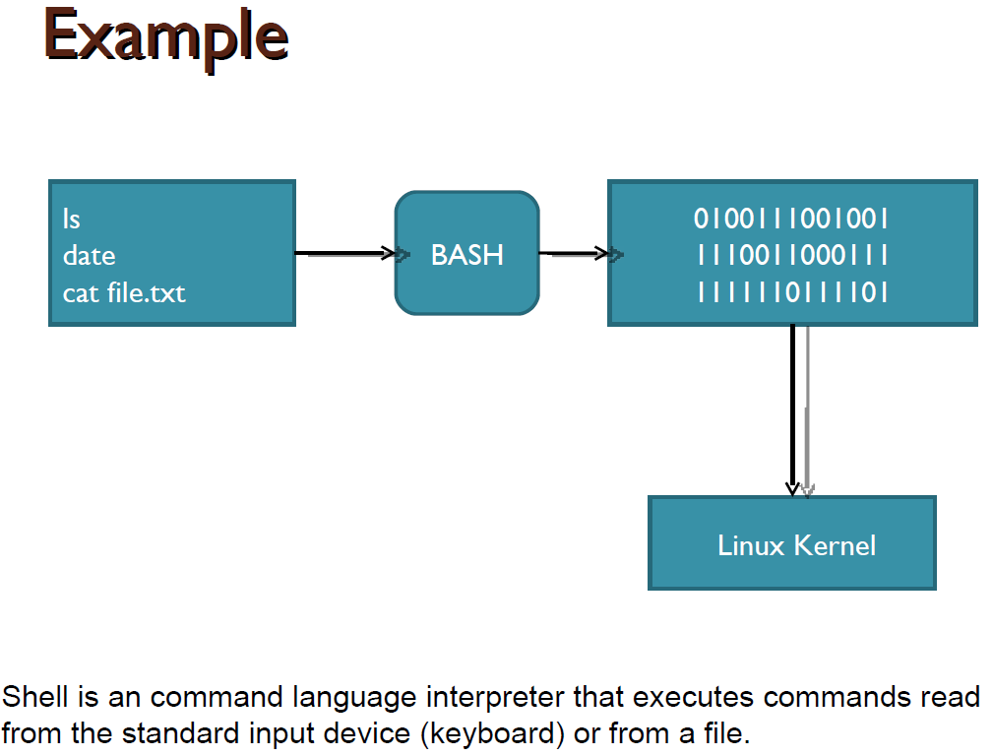

Slide 5
Changing Your Default Shell
 Tip: To find all available shells in your system type following command:
$ cat /etc/shells
 The basic Syntax :
chsh username new_default_shell
 The administrator can change your
default shell.

Slide 6
Shell Scripting
Shell script is a series of command(s) stored
in a plain text file.
A shell script is similar to a batch file in MSDOS,
but is much more powerful.

Slide 7
Practical examples where shell scripting actively used:
1. Monitoring your Linux system.
2. Data backup and creating snapshots.
3. Find out what processes are eating up your system resources.
4. Find out available and free memory.
5. Find out all logged in users and what they are doing.
6. Find out if all necessary network services are running or not.

Slide 8
Create a script
As discussed earlier shell scripts stored in plain text file, generally one command per line.
◦ vi myscript.sh
Make sure you use .bash or .sh file extension for each script. This ensures easy identification of shell script.

Slide 9
Setup executable permission
Once script is created, you need to setup executable permission on a script. Why?
Without executable permission, running a script is almost impossible.
Besides executable permission, script must have a read permission.
Syntax to setup executable permission:
◦ $ chmod +x your-script-name.
◦ $ chmod 755 your-script-name.

Slide 10
Run a script (execute a script)
Now your script is ready with proper executable permission on it. Next, test script by running it.
◦ bash your-script-name
◦ sh your-script-name
◦ ./your-script-name
 Examples
◦ $ bash bar
◦ $ sh bar
◦ $ ./bar

Slide 11
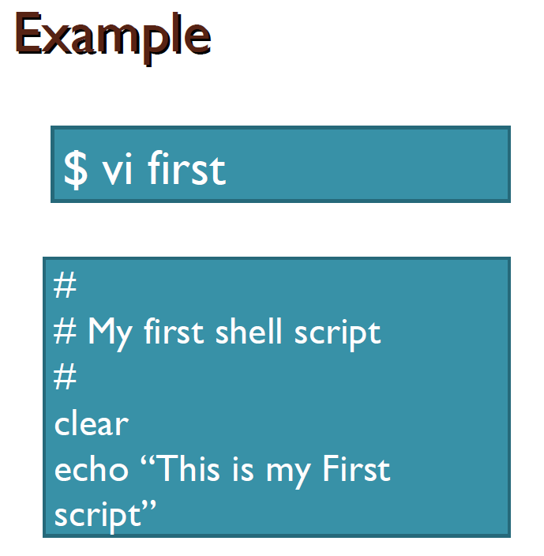

Slide 12
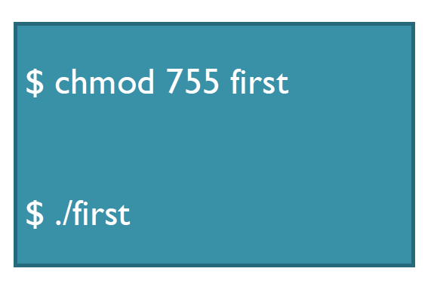

Slide 13
Using Exit code($?)
Every Linux or Unix command executed by the shell script or user has an exit status.
Exit status is an integer number. 0 exit status means the command was successful without any errors.
A non-zero (1-255 values) exit status means command was a failure.
Example
date test 1 –gt 0 ; echo $? echo $?

Slide 14
Variables in Shell
In Linux (Shell), there are two types of variable:
◦ System variables - Created and maintained by Linux itself. This type of variable defined in CAPITAL LETTERS.
◦ User defined variables (UDV) – Created and maintained by user. This type of variable defined in lower letters.

Slide 15
System Variables
Variable | Description
PATH | This variable contains a colon (:)-separated list of directories in which your system looks for executable files. The search path.
USER | The username
HOME | Default path to the user's home directory
EDITOR | Path to the program which edits the content of files
UID | User's unique ID
TERM | Default terminal emulator
SHELL | Shell being used by the user

Slide 16
User defined variables (UDV)
To define UDV use following syntax:
◦ variable name=value
◦ $ no=10
Rules for Naming variable name
Variables must begin with a letter.
Spaces are not allowed.
Underscore can be allowed.
No special character in variable name.
Variables are case-sensitive.

Slide 17
Print or access value of UDV
To print or access UDV use following
syntax :
◦ $variablename.
 Examples:
◦ $vech=Bus
◦ $ n=10
◦ $ echo $vech
◦ $ echo $n

Slide 18
Don’t try
◦ $ echo vech
◦ it will print vech instead its value 'Bus‘.
◦ $ echo n
◦ it will print n instead its value '10‘.
“You must use $ followed by variable name.”

Slide 19
Class work
1. Define variable x with value 10 and print it on screen.
2. Define variable xn with value SUST and print it on screen.
3. print sum of two numbers, let's say 6 and 3 .

Slide 20
Example of UDV
A=10
Ba=20
BA=30
HOSTNAME=$ (hostname)
DATE=`date`
123var=333
wrong@var=False
Hyphen-var=Falsehyphen value

Slide 21
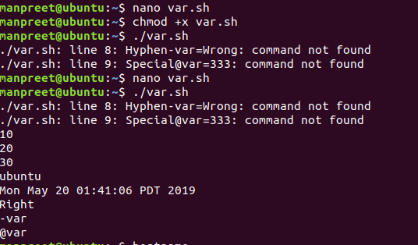

Slide 22
Shell Arithmetic
Syntax:
◦ expr op1 math-operator op2
 Examples:
◦ $ expr 1 + 3
◦ $ expr 2 – 1
◦ $ expr 10 / 2
◦ $ expr 20 % 3
◦ $ expr 10 \* 3
◦ $ echo `expr 6 + 3`

Slide 23
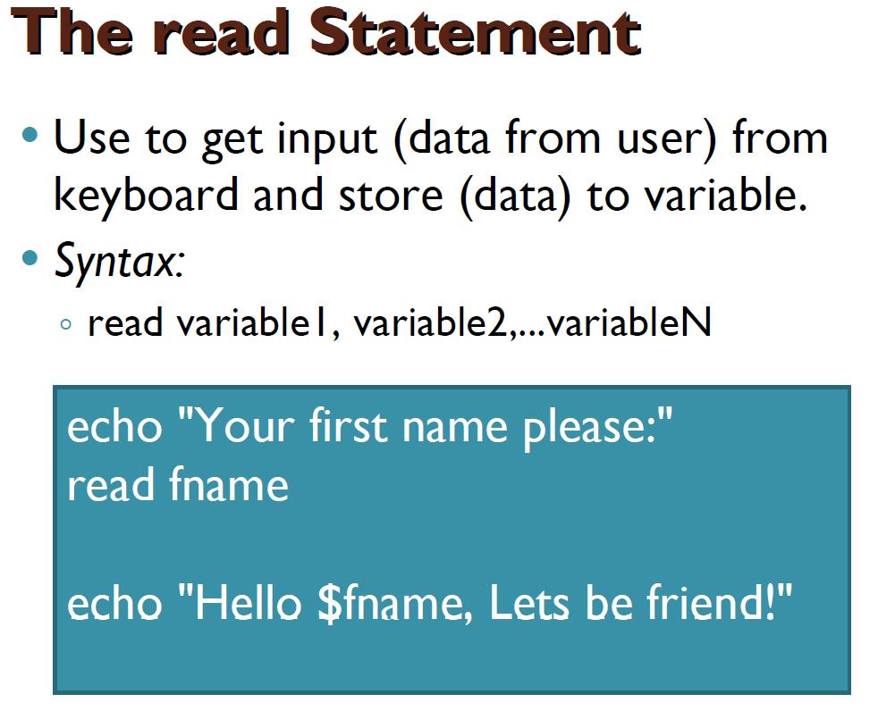

Slide 24
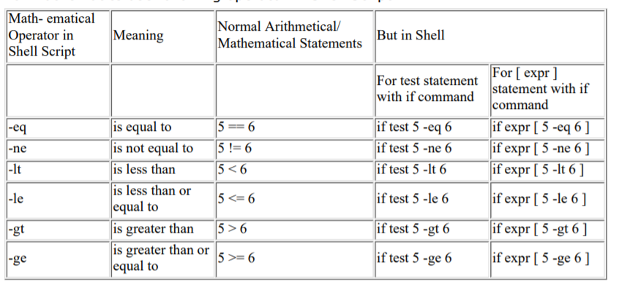
Shell Relational

Slide 25
Test command or [expr]
test command or [ expr ] is used to see if an expression is true, and if it is true it return zero(0), otherwise returns nonzero(>0) for false.
Syntax: test expression OR [ expression ]

Slide 26
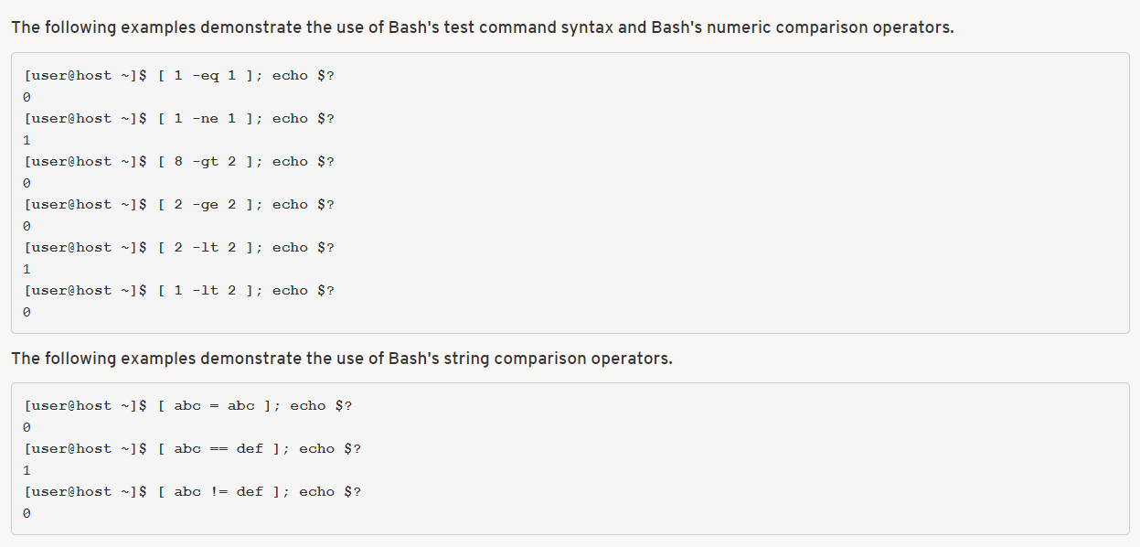

Slide 27
Example: Using the ! Operator
#!/bin/bash
read -p "Enter years of work: "Years
if [ ! "$Years" -lt 20 ]; then
echo "You can retire now.“
else
echo "You need 20+ years to retire“
fi

Slide 28
if condition
Syntax:
if condition
then
command1 if condition is true or if exit status
of condition is 0 (zero)
fi

Slide 29
Example
$ vim myscript.sh
read choice
if [ $choice -gt 0 ]; then
echo "$choice number is positive"
else
echo "$ choice number is negative"
fi

Slide 30
Nested if-else-fi
$ vi nestedif.sh
echo "1. Unix (Sun Os)"
echo "2. Linux (Red Hat)"
echo -n "Select your os choice [1 or 2]? "
read osch
if [ $osch -eq 1 ] ; then
echo "You Pick up Unix (Sun Os)"
else
if [ $osch -eq 2 ] ; then
echo "You Pick up Linux (Red Hat)"
else
echo "What you don't like Unix/Linux OS."
fi
fi

Slide 31
Loops in Shell Scripts
Bash supports:
1. for loop.
2.while loop.
Note that in each and every loop:
◦ First, the variable used in loop condition must be
initialized, then execution of the loop begins.
◦ A test (condition) is made at the beginning of each iteration.
◦ The body of loop ends with a statement that
modifies the value of the test (condition) variable.

Slide 32
for Loop
Syntax:
for { variable name } in { list }
do
execute one for each item in the list until the list is not finished and repeat all statement between do and done
done

Slide 33
Example
for i in 1 2 3 4 5
do
echo "Welcome $i times"
done

Slide 34
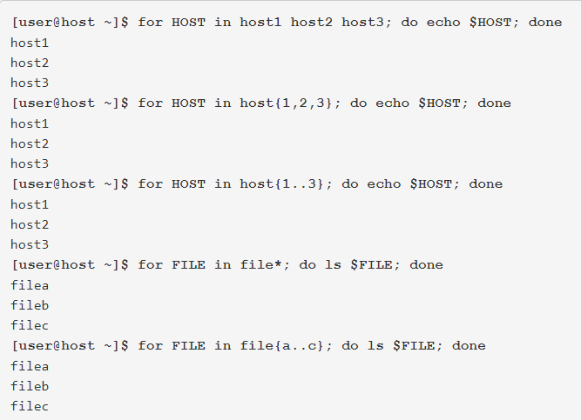

Slide 35
for Loop
Syntax:
for (( expr1; expr2; expr3 ))
do
repeat all statements between
do and done until expr2 is TRUE
Done

Slide 36
Example
for (( i = 0 ; i <= 5; i++ ))
do
echo "Welcome $i times"
done

Slide 37
Nesting of for Loop
$ vi nestedfor.sh
for (( i = 1; i <= 5; i++ ))
do
for (( j = 1 ; j <= 5; j++ ))
do
echo -n "$i "
done

Slide 38
while loop
Syntax:
while [ condition ]
do
command1 command2 command3 .. ....
done

Slide 39
Example
i=1
while [ $i -le 10 ]
do
echo "$n * $i = `expr $i \* $n`"
i=`expr $i + 1`
done

Slide 40
The case Statement
Syntax:
case $variable-name in
pattern1) command…..;;
pattern2) command…..;;
pattern N) command….;;
.
*) command ;;
esac

Slide 41
Example
read var
case $var in
1) echo “One”;;
2) echo “Two”;;
3) echo “Three”;;
4) echo “Four”;;
*) echo "Sorry, it is bigger than Four";;
esac

